Slide 1
NHS - PAEDIATRIC MOVEMENT THERAPY
CQUIN
Dr Charlie Fairhurst
18th June 2021

Slide 2
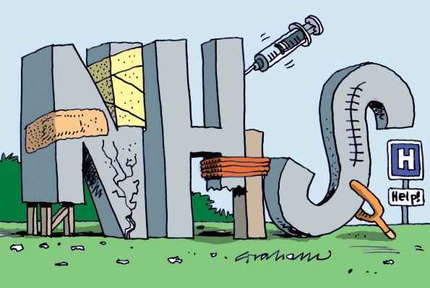

Slide 3
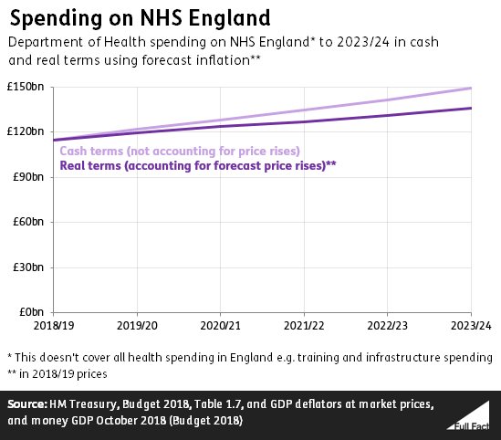

Slide 4
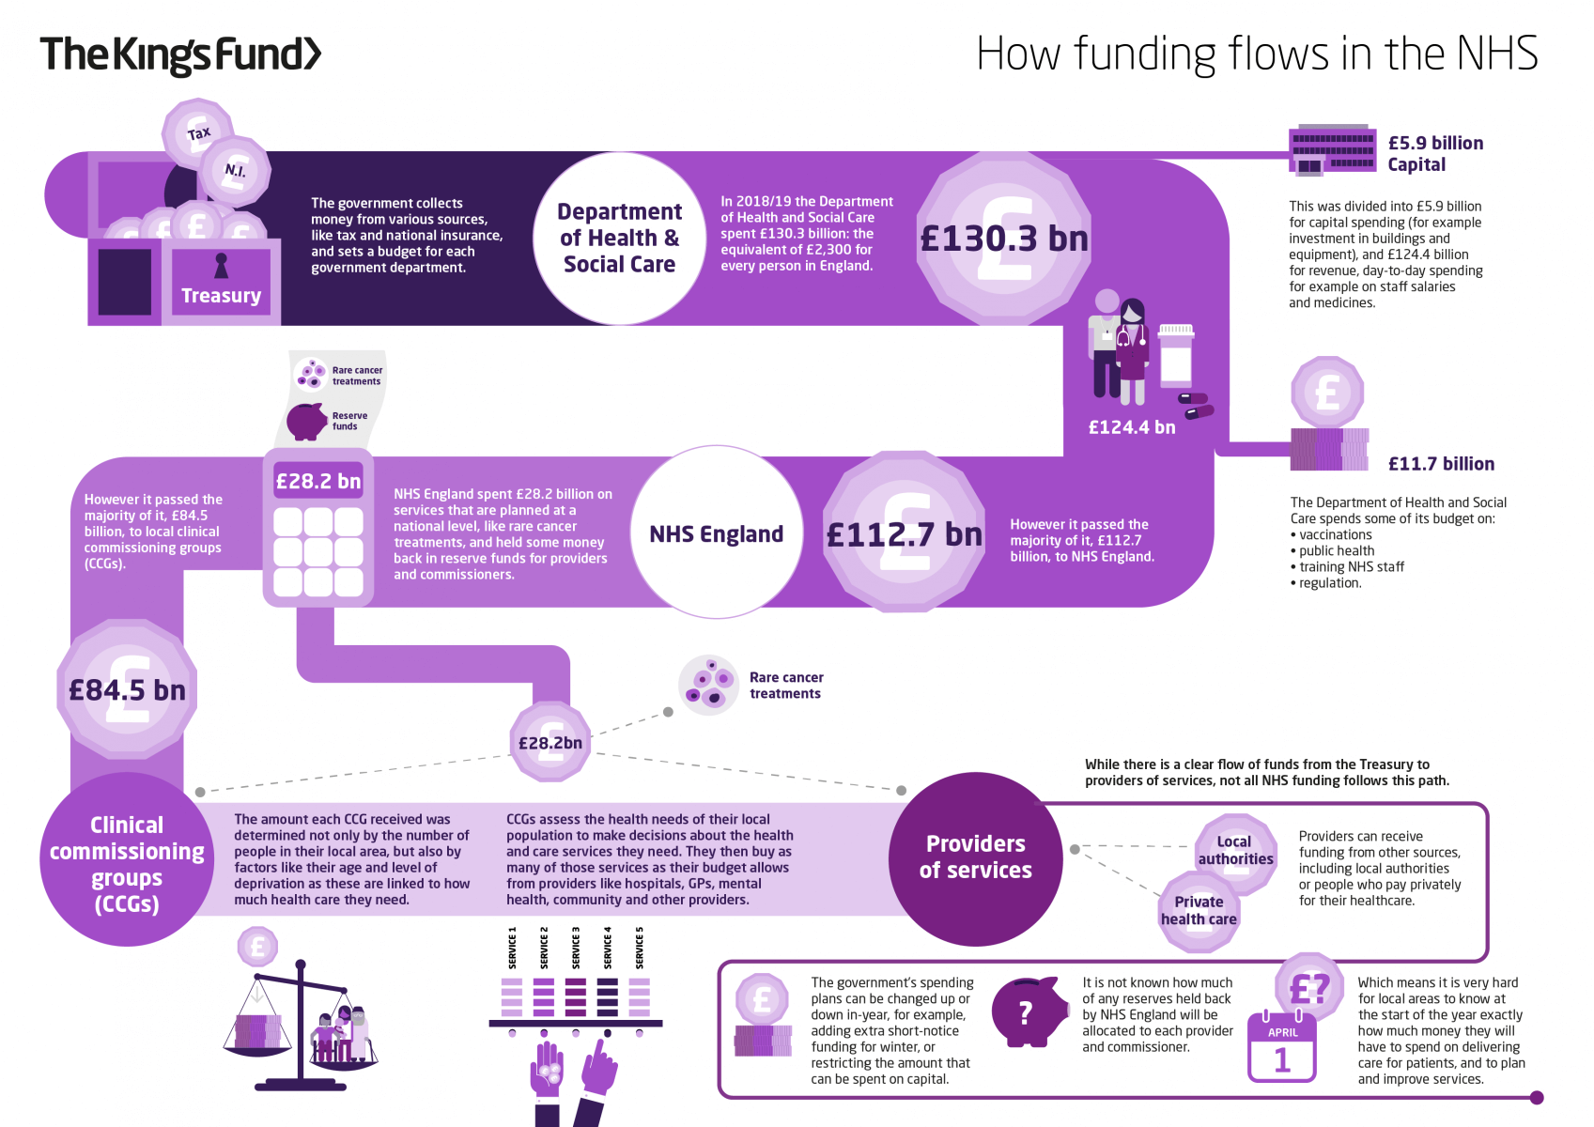

Slide 5
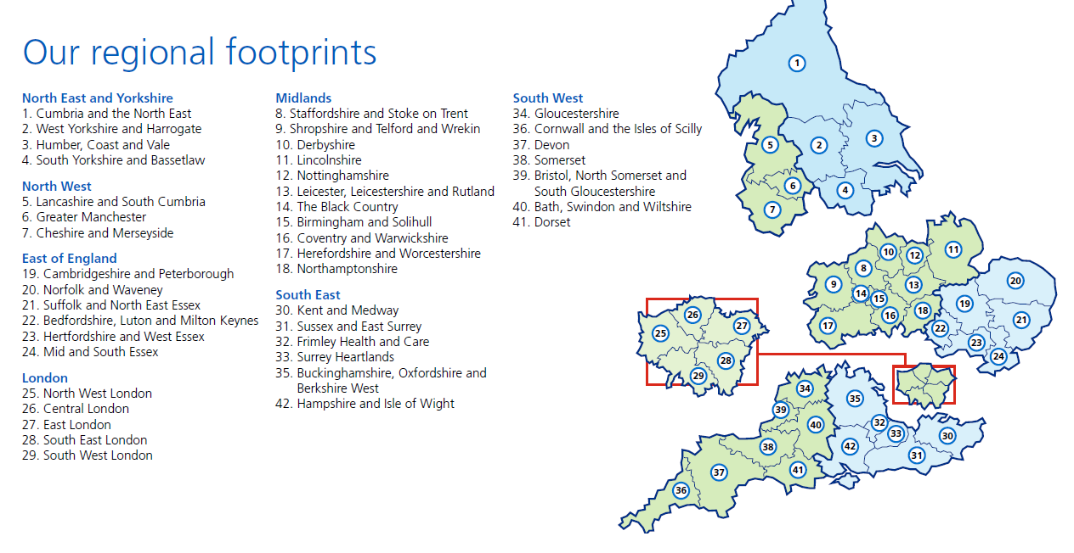

Slide 6
10 ODNs in NHSE structure – critical care ODNs
This map outlines the ODN footprints based on existing patient flows and historical working arrangements. In general, these are aligned with the current areas for PCC Specialist Transport Provision.
The plan is for NHS Trusts lying near ODN boundaries to have a choice in taking part in either or both ODNs, depending on practical demands.
However, clinical decision-making around referral to the most appropriate critical care units will take priority over the ODN boundaries.
Close working between the ODNs and commissioners (via ODN Boards) will enable the ODNs to have greater influence over services and address local quality issues.
North East and Cumbria
Yorkshire and
the Humber
North West
East Midlands
West Midlands
East of England
Thames
Valley
and
Wessex
North London
South Thames
South West
1

Slide 7
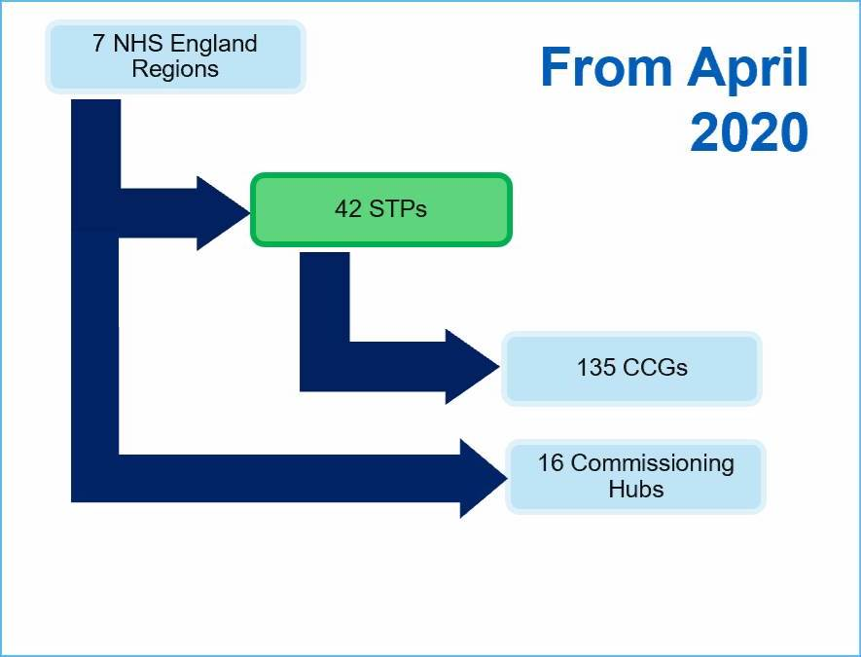

Slide 8
Specialised Commissioning
Specialised services are those provided in relatively few hospitals, accessed by comparatively small numbers of patients but with catchment populations of usually more than one million.
These services tend to be located in specialised hospital Trusts that can recruit a team of staff with the appropriate expertise.
Specialised services account for approximately 10% of the total NHS budget
146 different specialised services managed through national, and regional teams supported by Programmes of Care
300 plus provider contracts
Commissioned on the basis of geography rather than population
Move to ‘bulk contracts’ rather than historical ‘payment by result tariffs’

Slide 9
Aim of Specialised Commissioning
Improve Access
Improve Equity
Improve Quality
Improve Value

Slide 10
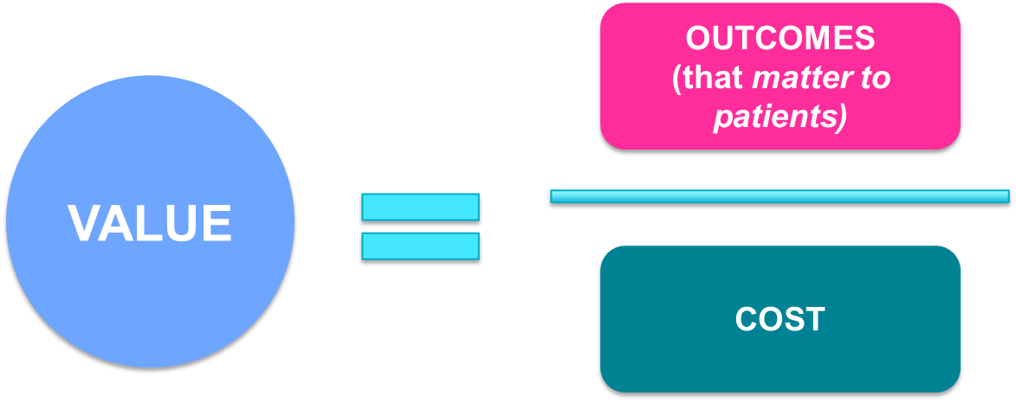
Improving Value
Improving Value in specialised commissioning aims to achieve measurable improvement in patient benefit or outcome whilst achieving a reduction in the cost of specialised services.
Changing how specialised services are delivered
Changing how we transact for specialised services
Reducing demand for specialised services
Value in healthcare is a relationship between patient outcome and costs.
(positive outcome = benefit - harm)
By reducing variation (and improving the mean) in patient benefit & outcome, harm and costs of healthcare we can improve value.

Slide 11
Specialised and Highly Specialised Services
NHS England Board
SCOG provides oversight of delivery and sets strategic direction
Specialised Services Committee (SSC)
Implementation of change delivered through 7 Regions and 16 Commissioning Hubs
Operational Plan (National)
Specialised Commissioning Oversight Group (SCOG)
Specialised Commissioning SMT (National)
Clinical Prioritisation Advisory Group
(CPAG)
Operational Plan
(Regional)
National Programme / Project Boards
Regional Performance Boards
SMT provides operational support for delivery
Rare Diseases Advisory Group
(RDAG)
National Functions
Programmes of Care/ CRGs
Hub Performance Boards
Service Reviews

Slide 12



Slide 13

Central CPIP funding pre 2018

Slide 14
ACCESS, QUALITY and EQUITY
                Post Selective Dorsal Rhizotomy implementation

Slide 15
QUALITY and EQUITY
Post Selective Dorsal Rhizotomy work up to implementation 2016-2018
    ODNs funding dropped 2016
    NICE guidelines
      Spasticity 2012
      Cerebral Palsy 2017 / 2019
2018-19 Commissioning for Quality and Innovation (CQUIN) development – NHSe CRG / PoCB
  Overall Movement therapy review
Commissioners highlighted
Variation in service provision across UK
  Assessment of tone and movement
  Intervention – tone / movement / therapy / activity / participation
  CPIP uptake, data collection and pathways

Slide 16
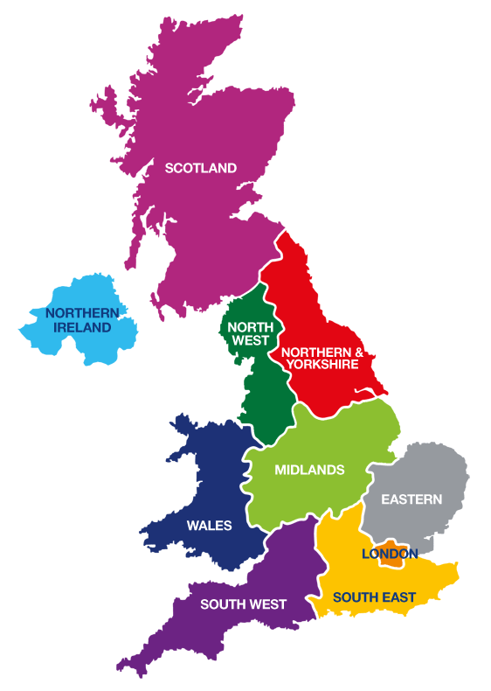
7 NHS regions
RMCH
Alder Hey
Newcastle
Leeds
Sheffield
Nottingham
Birmingham
RJAH Oswestry
Coventry
Cambridge
GOSH
C&W RLH
Bristol
Oxford
Southampton
ELCH / KCH
St George’s

Slide 17
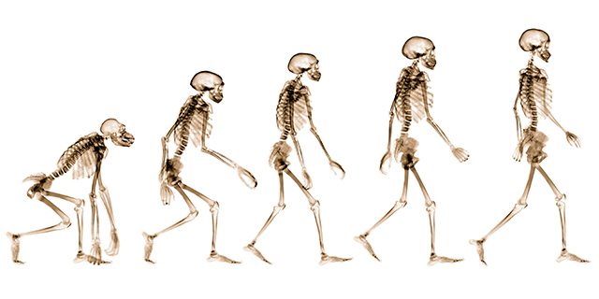
CQUIN development 20-21-22
CPIP focus
Central funding data collection – Dundee
Agreed protocols
  Assessment
  Intervention – tone Rx / therapy / Orthopaedics???
Prevent duplication
  Neurosciences CRG – tone management CPIP
  Specialist orthopaedics – spec. surgery in Children CRG
Networks
  Referral into each centre – CPIP
  Regional collaboration – Pathways of care
  National collaboration – Between centres

Slide 18

Triggers = expectations by NHSe
Each centre responsible to support only their own referral network, but must work with other centres regionally / nationally
1 virtual MDT in 18 weeks 66%
  Review pathway
2 CPIP support within own area of responsibility – neuro / orth
3 Support own referral network – early management pathways
4 Data collection IG / Data protection
  Referrals, assessments, interventions, outcomes, onward referrals
  Reviewing centrally

Slide 19


Slide 20


